Slide 1



A ONE-STOP SOLUTION FOR LEARNING AND GROWTH
TEAM NAME: DevElevate
ORGANIZATION NAME: BIJU PATNAIK UNIVERSITY OF TECHNOLOGY,ROURKELA

Slide 2


P
ROBLEM STATEMENT
Despite advancements in digital education, e-learning platforms often lack engagement, personalization, and hands-on experiences, reducing skill retention. How can we design an AI-driven, gamified system with real-time analytics to enhance engagement, personalize learning, and ensure effective skill development?
SCATTERED RESOURCES
LACK OF PROPER GUIDANCE
QUALITY CONCERNS
OVERWHELMING CHOICES
Learners waste time searching for courses, notes, and tutorials.
Hard to differentiate between reliable and low-quality content
No clear roadmap on how to learn a skill step-by-step
Too many platforms, making decision-making difficult.

Slide 3
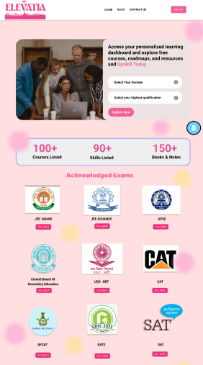
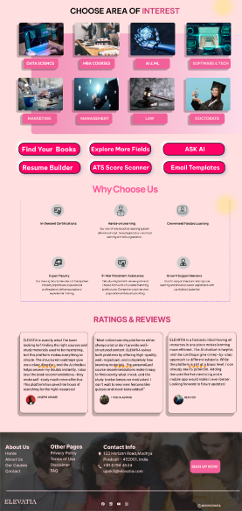
OUR APPROACH
(DESIGN PROTOTYPE)
TIME-SAVING
HANDPICKED QUALITY CONTENT
CAREER-ORIENTED APPROACH
No need to search across multiple platforms; everything is readily available.
We ensure only the best and most relevant courses, notes, and videos are listed.
Designed to help learners gain job-ready skills with structured learning.
CENTRALIZED LEARNING
STRUCTURED ROADMAPS
DOMAIN-SPECIFIC LEARNING
All necessary resources in one place.
Clear step-by-step learning paths for different domains.
Tailored resources.
FREE & QUALITY CONTENT
USER-FRIENDLY INTERFACE
COMMUNITY & UPDATES
Handpicked courses, notes, and tutorials.
Easy navigation and accessibility.
Latest content + peer support.

Slide 4
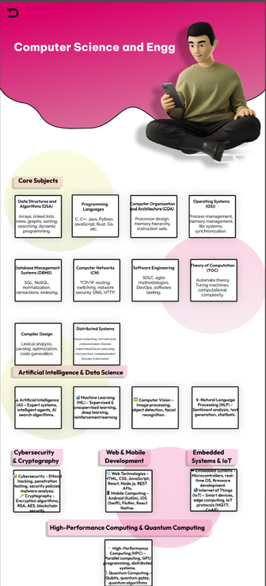
K
EY FEATURES
ADMIN PANEL
FRIENDLY DESIGN
Enables content updates, new roadmap additions, and book management.
Works seamlessly across mobile, tablet, and desktop.
FREE COURSE LINKS
STRUCTURED LEARNING ROADMAPS
AI-ASSISTED CHATBOT
PERSONALIZED COURSE SUGGESTIONS
Direct access to quality courses across multiple subjects like programming, data structures, and more.
Step-by-step guides for domains like Web Development, Data Science, and GATE prep.
Smart chatbot for study help, career guidance, and instant recommendations.
Recommends courses based on user interests and learning history.
BOOK RECOMMENDATION
RESUME BUILDER & SCANNER INTEGRATED
EMAIL TEMPLATES
SAVE & BOOKMARK RESOURCES
Suggests subject-specific books with descriptions and access links.
Users can create and scan resumes to check their ATS score.
Email templates are available for various topics as needed.
Users can save courses, books, and roadmaps for easy access.

Slide 5











TECH STACK
FRONTEND
BACKEND
API INTEGRATION
FRAMEWORK
DATABASE

Slide 6
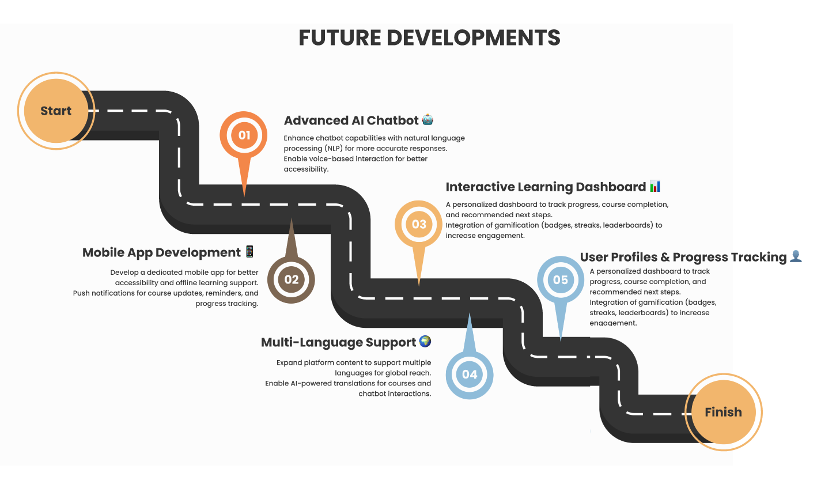
FUTURE DEVELOPMENT PLANS

Slide 7
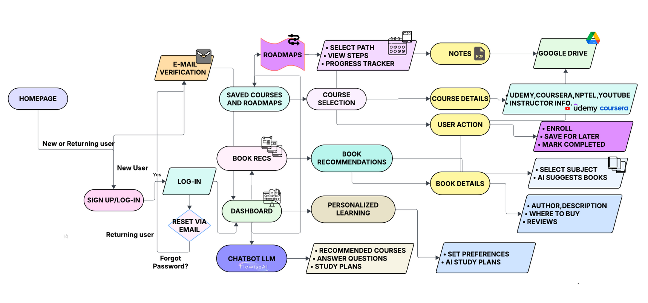
FLOWCHART

Slide 8

THANK YOU!

